Slide 1
Week 4
THE relational algebra Binary operation of INNER JOIN (Natural Join and equi join)

Slide 2
Student Objectives
Upon completion of this video, you should be able to:
Identify the symbols for natural join and equi join.
Determine if the join will be possible based on the given tables and join information.
Write a relational algebra expression that uses JOINS given two tables based on a given query.
Given 2 tables and a JOIN relational algebra expression, show the new table that would be returned once the expression is performed.
Given a JOIN relational algebra expression and two tables, explain in simple English what query is answered by the expression.

Slide 3
JOIN
A join is just a Cartesian Product X with a Selection σ to find matches. The selection will remove some of the rows/tuples from the returned Cartesian Product.
The attributes that will be in the new table depends on if you are doing an equi join or a natural join
Symbol → ⋈
Example Expression:
Table1
ID | FirstName | LastName | Age
12 | Homer | Smith | 24
24 | Gene | Simpson | 33
45 | Walter | Reid | 33
Table2
ID | FirstName | LastName | Age
33 | Marg | Jones | 28
24 | Gene | Simpson | 33
Table1 ⋈ Table2 (natural join) Table1 ⋈ columnnametable1=columnnametable2Table2 (equi join)
ANSWER FOR Table1 ⋈ _{Age=ID} Table2
ANSWER FOR Table1 ⋈ Table2
Symbol for Join and maybe a subscript saying which column to join on.
Second Table Name
ID | FirstName | LastName | Age
24 | Gene | Simpson | 33
ID | FirstName | LastName | Age | Table2.ID | Table2.FirstName | Table2.LastName | Table2.Age
12 | Homer | Smith | 24 | 24 | Gene | Simpson | 13
24 | Gene | Simpson | 33 | 33 | Marg | Jones | 28
45 | Walter | Reid | 33 | 33 | Marg | Jones | 28
First Table Name

Slide 4
MORE ON Joins
R ⋈ _{Boolean formula} S: Produces a relation that contains tuples satisfying a condition from the Cartesian Product of R X S where the formula can contain comparisons using one of <,<=,>,>=,=,<> connected by and, or and not
Example: Department ⋈ _{ManagerSSN = SuperSSN} Employee Staff ⋈ Salary > Salary and JobLevel=JobLevel Manager

Slide 5
Natural Join More Info:
If the two tables being joined have the same attribute name(s), it is a natural join and the attribute will only show up ONCE in the resulting table
The natural join includes EACH pair of attributes with the same name, “AND” ed together, for example:
Q ← R(A,B,C,D) ⋈ S(C,D,E)
Result would only keep one copy of each pair
R.C=S.C AND R.D = S.D
and would give: Q(A,B,C,D,E)

Slide 6
Equi Join: when all of the comparisons are =, then it is called an equi join and pairs of the attributes are returned that are equal (i.e. attribute from both sides of the equals are returned).
Natural Join: when all of the comparisons are = and it matches any attribute in Table1 that has the same name as the attribute in Table2. The attribute is only shown once.
Table1
Answer ← (π A (Table1)) ⋈ Table2
Answer ← Table1 ⋈ _{D < D} Table1
Answer ← Table1 ⋈ Table2
Answer ← Table1 ⋈ _{C=C}Table2
Answer ← Table1 ⋈ _{A=A}Table2
A | B | C | D
7 | Cow | Pink | 22
8 | Dog | Pink | 33
9 | Cow | Red | 44
A | B | C | D
7 | Cow | Pink | 22
8 | Dog | Pink | 33
9 | Cow | Red | 44
Answer
A | E | C | F | D | B
8 | Cat | Pink | Hat | 33 | Dog
A | E | C | F | D
8 | Cow | Pink | Shoe | 44
8 | Cat | Pink | Hat | 33
Table1.A | Table2.A | E | Table1.C | F | Table1.D | B | Table2.C | Table2.D
8 | 8 | Cow | Pink | Shoe | 33 | Dog | Pink | 44
8 | 8 | Cat | Pink | Hat | 33 | Dog | Pink | 33
A
7
8
9
Table1.A | B | Table1.C | Table1.D | Table2.A | E | Table2.C | F | Table2.D
7 | Cow | Pink | 22 | 8 | Cow | Pink | Shoe | 44
7 | Cow | Pink | 22 | 8 | Cat | Pink | Hat | 33
8 | Dog | Pink | 33 | 8 | Cow | Pink | Shoe | 44
8 | Dog | Pink | 33 | 8 | Cat | Pink | Hat | 33
Table2
A | E | C | F | D
6 | Cow | Blue | Hat | 33
6 | Cow | Blue | Sock | 44
8 | Cow | Pink | Shoe | 44
8 | Cat | Pink | Hat | 33
A | B | C | D | Table1.A | Table1.B | Table1.C | Table1.D
7 | Cow | Pink | 22 | 8 | Dog | Pink | 33
7 | Cow | Pink | 22 | 9 | Cow | Red | 44
8 | Dog | Pink | 33 | 9 | Cow | Red | 44

Slide 7
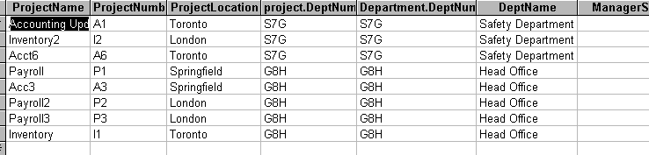
More realistic Examples of Joins:
Example 1:
Equi Join on Department and Project:
Project ⋈ Project.DeptNumber = Department.DeptNumber Department

Slide 8
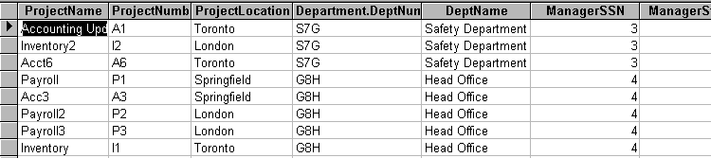
Example 2:
Natural Join on Department and Project:
Project ⋈ Department

Slide 9
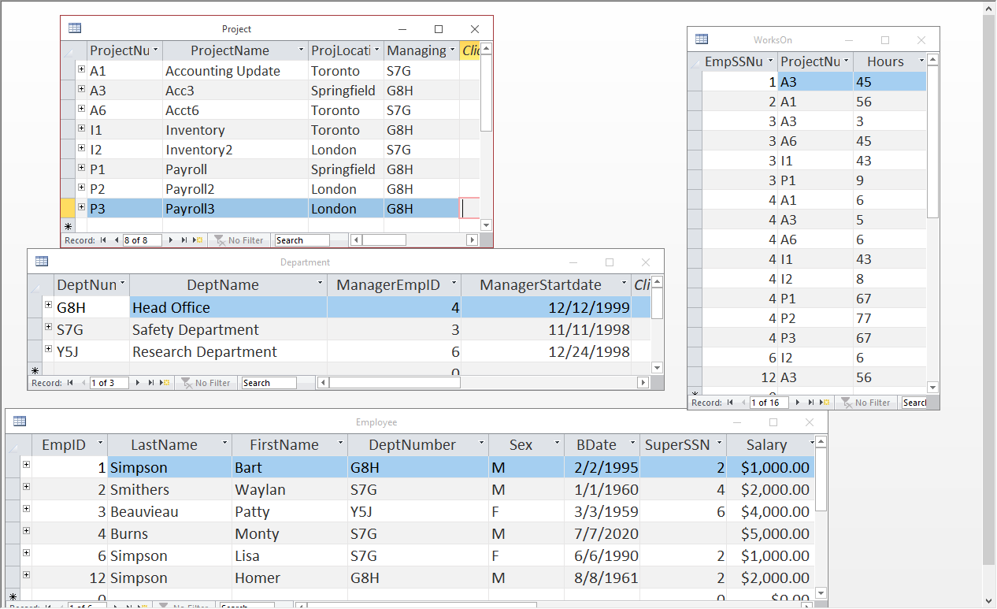
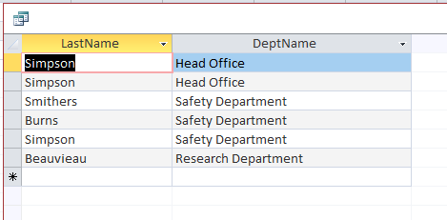
QUESTION: What will be the resulting table of the following relational algebra expression?
π _{LastName, DeptName} (Employee ⋈ Department)
QUESTION: What does the above result represent in English?
ANSWER: Show me all the Employee’s last names and the name of the Department that they have been assigned to.

Slide 10
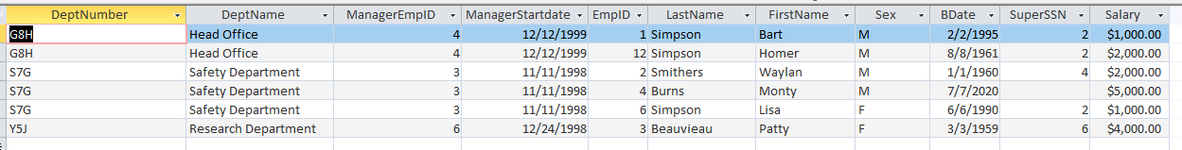
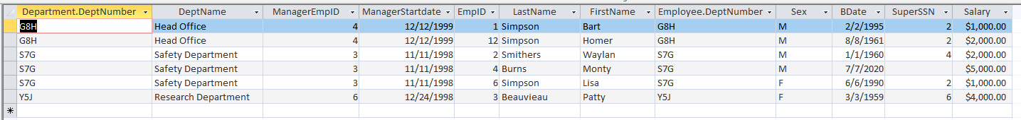
QUESTION: What will be the difference that will result in the answers in the following two relation algebra expressions?
Expression 1: Employee ⋈ Department
Expression 2: Employee ⋈ _{DeptNumber = DeptNumber} Department

Slide 11
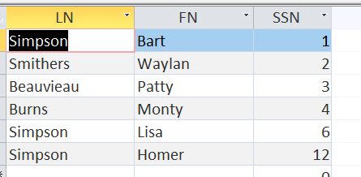
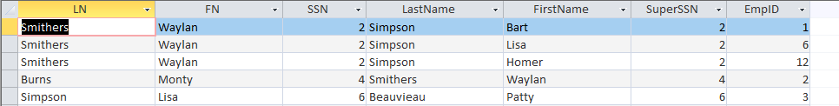
QUESTION: What will the following expression return?
Temp(LN, FN, SSN) ← π _{LastName,FirstName,EmpID} (Employee)
Result ← Temp⋈_{SSN=SuperSSN}(π LastName,FirstName,SuperSSN,EmpID(Employee))
QUESTION: In English, what does the above expression represent?
ANSWER: Show me the id and first and last names of the supervisors and the ids and first and last names of the employees that they supervise.

Slide 12
QUESTION: Write the Relational Algebra expression to print the department name, and the manager's first and last name:
QUESTION: Write the Relational Algebra expression to display department names of departments who have people making more than 4,000 dollars.
π _{DeptName, LastName, FirstName} (Employee ⋈ _{EmpID = ManagerEmpID} Department)
TEMP ← π _{DeptNumber} (σ _{Salary > 4000} (Employee))
ANSWER← π _{DeptName} (TEMP ⋈ Department)

Slide 13
QUESTION: Write the Relational Algebra expression to print the first and last name of all employees, the name of the projects they work on and the number of hours they work on each project. (This is a join for a many to many relationship)
TEMP ← π FirstName, LastName, ProjectNumber,Hours (EMPLOYEE ⋈ _{EmpID=EmpSSNNumber}WORKSON)
ANSWER← π FirstName, LastName, Hours,ProjectName (TEMP ⋈ PROJECT)
OR
ANSWER← π FirstName, LastName, Hours,ProjectName (EMPLOYEE ⋈ _{EmpID=EmpSSNNumber}WORKSON ⋈ PROJECT)

